Slide 1


Slide 2
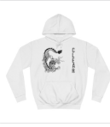
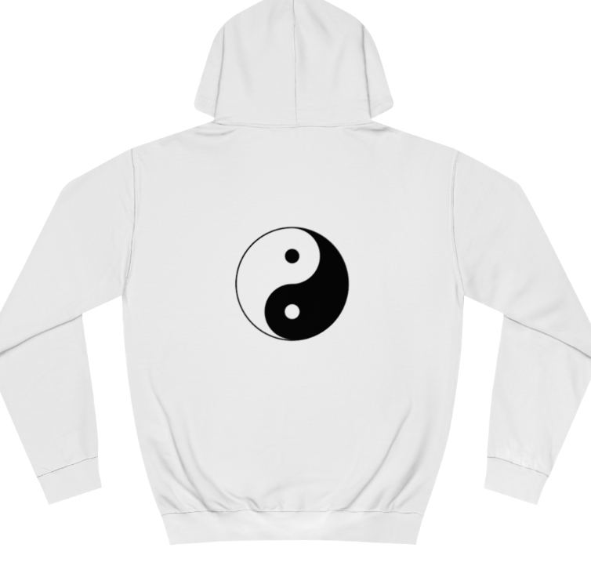

Hi welcome to clear.co this is name of an amazing upcoming brand for the future of you and clothing are we wont you to be apart of are team and help support are business thank you

Slide 3
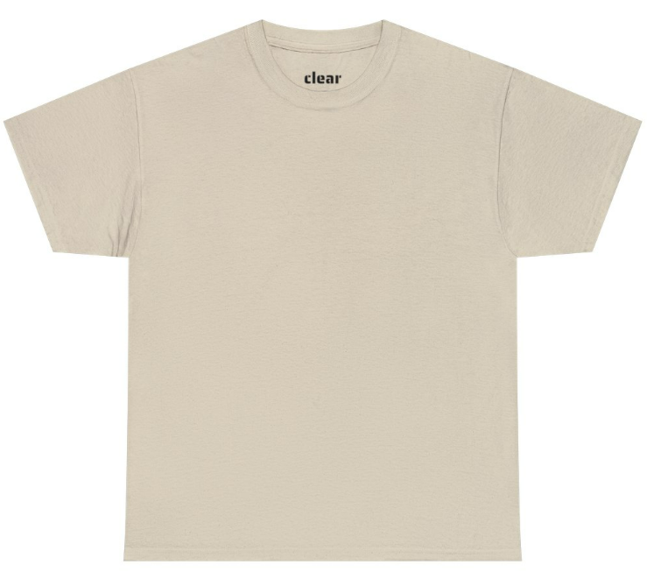

Personal designer, we have a team of people produce new shirts, shorts and more if you email us ( clear.co.clothes@gmail.com ) we can do personal orders from are shop to you for a higher cost from $5 to $10 if interested send a personal email to the one above.

Slide 4
Prices
Beanies are sold for$25 each
Hoodies are sold for $ 45 each
Shirts are sold from $30 to $45 each
Shorts are sold from $40 to $50
To check confirmed prices, follow this link https://clearco.printify.me/products

Slide 5
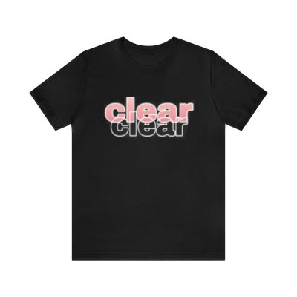
Sale prices
From June 1st to June 15th
Are team gives a 10% of any order from are shop
(https://clearco.printify.me/products)
Christmas expenses
From the 1st of December to
January 1st clear.co charges extra on your order for shipping over this time (https://clearco.printify.me/products)

Slide 6


